Slide 1
East-West University Library
Instructions of finding a book in the Electronic Catalog

Slide 2
To search for the desired book, you need to enter the website of East-West University www.eastwest.edu.ge. You open the electronic catalog in the library section.

Slide 3
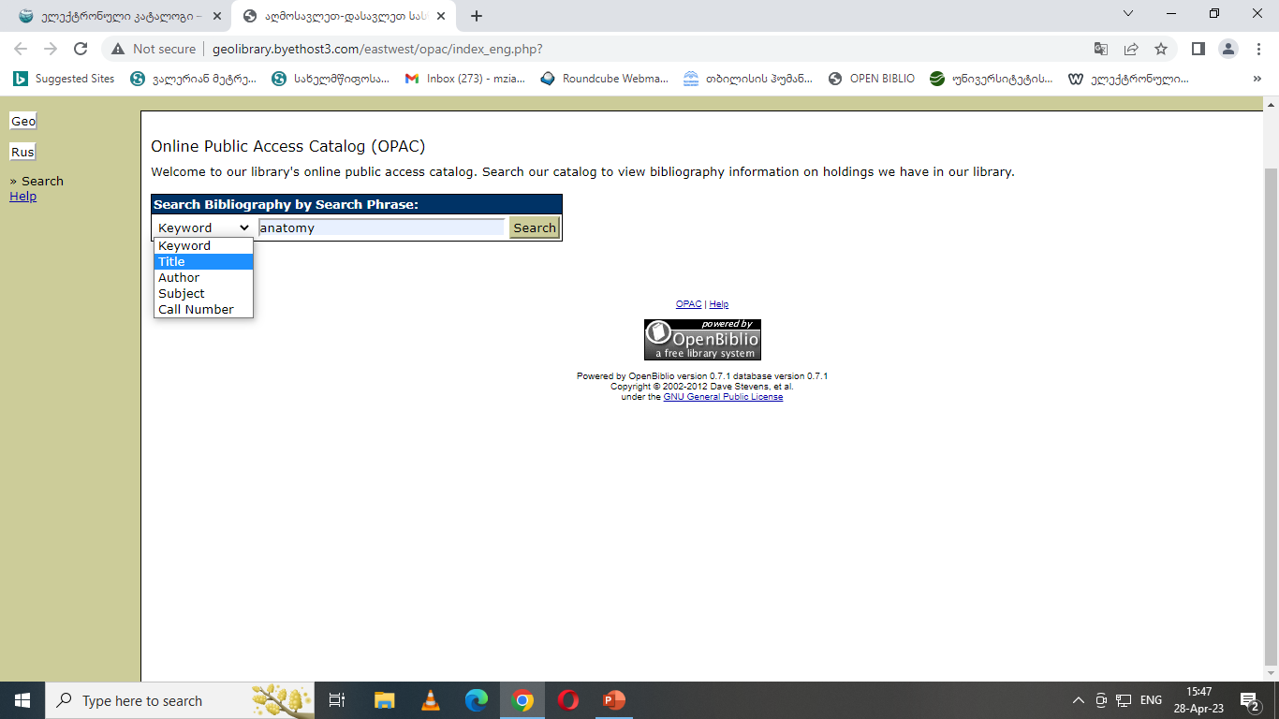
. In the window of the electronic catalog, you write a keyword (title, author, subject). For example, we wrote "Anatomy".

Slide 4
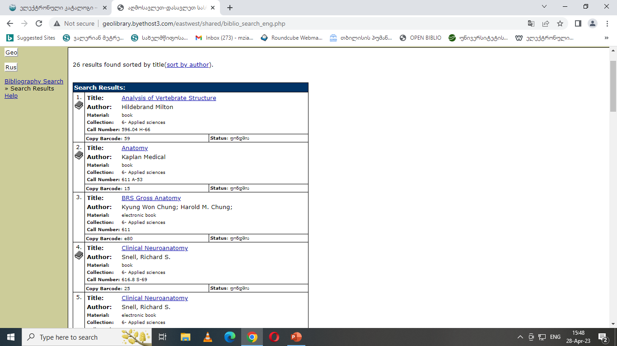
As a result, 26 records were found. For example, we select "BRS Gross Anatomy" and open it.

Slide 5
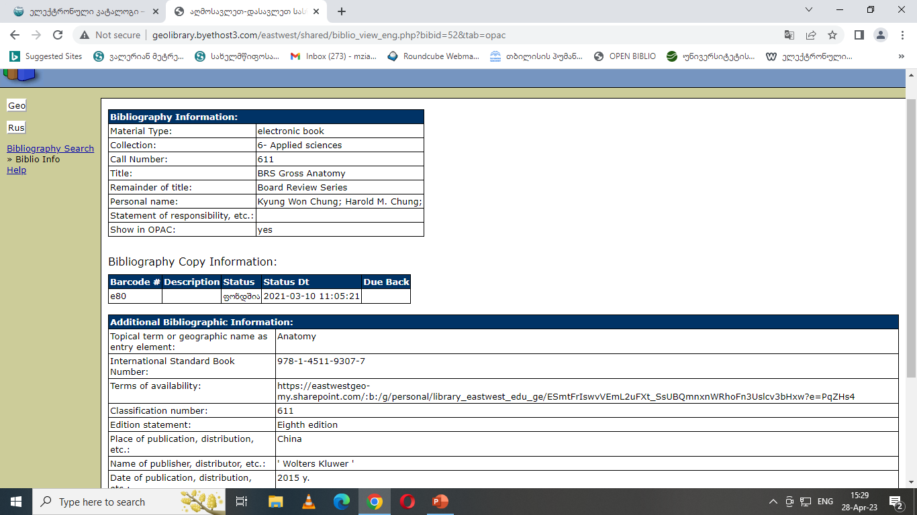
The full description of the book opens. The book number is e80. The book with the mentioned number is uploaded to Google Drive.

Slide 6
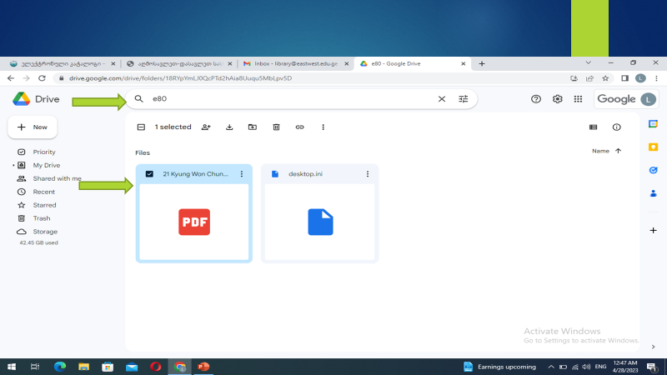
. You write the book number e80 in the search window and the PDF file opens

Slide 7
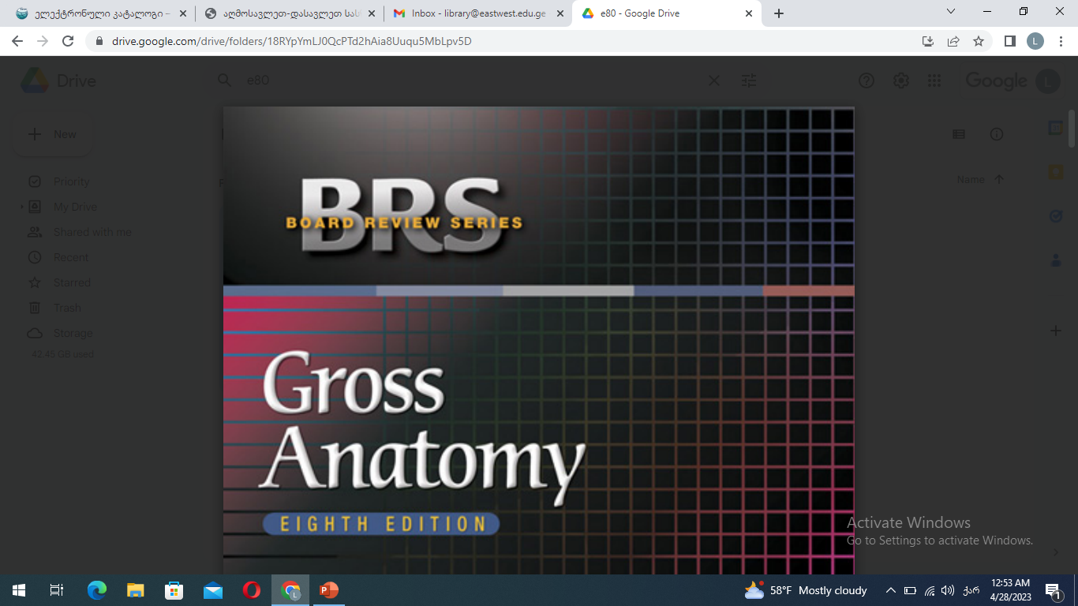
You can open the book and read.

Slide 8
East-West University Library Wishes You Success

